Slide 1



Hypothesis Testing
Moringa School |
www.moringaschool.com

Slide 2


Random callouts
Content Walkthrough

Slide 3
Hypothesis Testing
Objective
Identify the steps of hypothesis testing.
Define the null hypothesis, alternative hypothesis, level of significance, test statistic, p-values, and statistical significance.

Slide 4
Introduction
Hypothesis testing is a statistical method used to make decisions about the population based on sample data. It involves making an assumption (the null hypothesis, H₀) and determining whether the data provide enough evidence to reject this assumption in favor of an alternative hypothesis (H₁)

Slide 5
Terms to be applied
Hypothesis testing
The Null hypothesis
The alternative
Test statistic
P-value
Confidence interval

Slide 6
Definition of Terms
Hypothesis testing -This is a systematic way to select samples from a group or population with the intent of making a determination about the expected behavior of the entire group.
The Null hypothesis - This is a statement about the population that either is believed to be true or is used to put forth an argument unless it can be shown to be incorrect beyond a reasonable doubt
The alternative- This is a claim about the population that is contradictory to the null hypothesis and what we conclude when we reject the null hypothesis.
Test statistic - This is a value computed from sample data and is used to help us decide whether to either accept or reject the null hypothesis
P-value - This is the probability of getting the observed results of a test, assuming that the null hypothesis is true

Slide 7
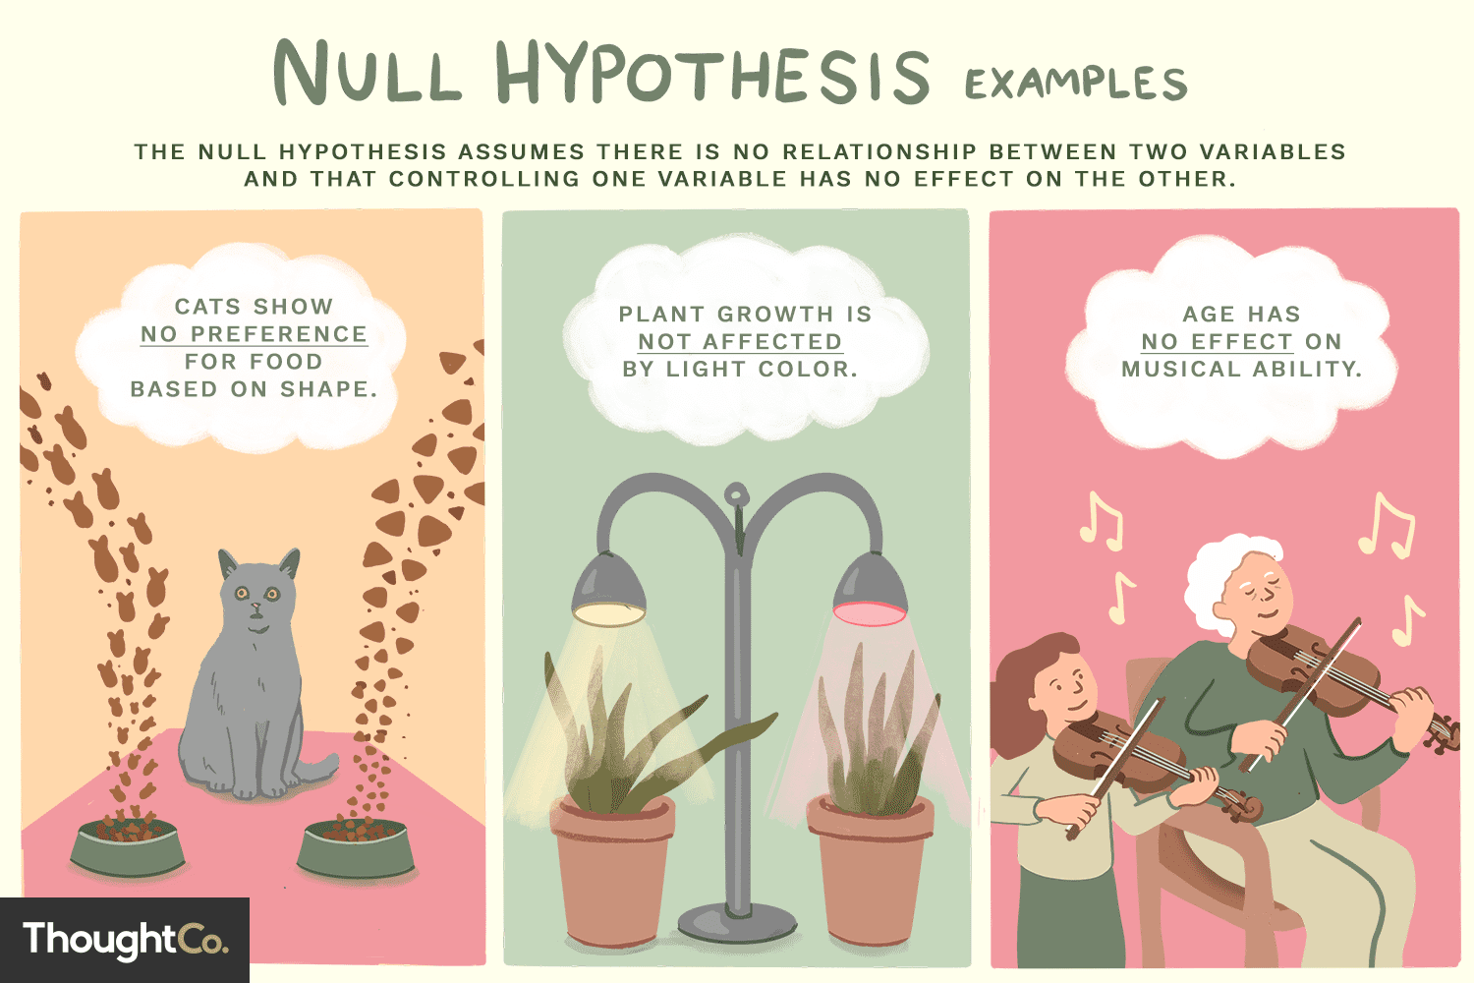
The null hypothesis (H₀) is a statement in statistical hypothesis testing that assumes there is no effect, relationship, or difference in a population. It serves as the default or baseline assumption that the observed data or results occur purely by chance. The goal of hypothesis testing is to either reject or fail to reject the null hypothesis based on sample data.

Slide 8
The alternative hypothesis (H₁ or Ha) is a statement in hypothesis testing that contradicts the null hypothesis. It represents the idea that there is a real effect, relationship, or difference in the population, and it is what researchers are often hoping to support with their data. If the null hypothesis is rejected, the alternative hypothesis is considered to be more likely true

Slide 9
 | Null | Alternate
Definition | statement that states that there is no relationship between two phenomenons under consideration or that there is no association between two groups | statement that describes that there is a relationship between two selected variables
Symol | H0, | HIt is denoted by H1 or Ha.
Acceptance | If the p-value is greater than the level of significance, the null hypothesis is accepted. | If the p-value is smaller than the level of significance, an alternative hypothesis is accepted
Mathematical expression | It is followed by ‘equals to’ sign. | followed by not equals to, ‘less than’ or ‘greater than’ sign.
Observation | believes that the results are observed as a result of chance. | believes that the results are observed as a result of some real causes
Nature | researcher tries to disprove | researcher tries to prove

Slide 10
Steps to determine whether to reject a null hypothesis
Step 1: state the two hypotheses so that only one can be right
Step 2 Choose the Significance Level (α) : significance level, typically set at 0.05, defines the threshold for determining whether the results are statistically significant.
Step 3: carry out the plan and physically analyze the sample data, that involves computing the p-values, values greater than cv means rejecting the null hypothesis
Step 4: Find the P-value and compare to the significance level
If p-value ≤ α: Reject the null hypothesis (H₀). There is strong evidence that the alternative hypothesis (H₁) is true.
If p-value > α: Fail to reject the null hypothesis (H₀). There isn’t enough evidence to support H₁
Notes:
1. State the Hypotheses
Null Hypothesis (H₀): This assumes no effect or difference.
Alternative Hypothesis (H₁): This represents the effect or difference you are testing for.
Example:
H₀: The new drug has no effect on blood pressure.
H₁: The new drug reduces blood pressure.
2. Choose the Significance Level (α)
The significance level, typically set at 0.05, defines the threshold for determining whether the results are statistically significant.
A smaller α (e.g., 0.01) means you require stronger evidence to reject the null hypothesis.
3. Collect and Analyze Data
Perform the experiment or collect the necessary data.
Use an appropriate statistical test (e.g., t-test, ANOVA, chi-square) based on the type of data and hypotheses.
4. Calculate the Test Statistic
The test statistic (e.g., t-statistic, z-statistic) is computed based on the sample data.
It helps determine how far the observed results deviate from the null hypothesis.
5. Find the P-value
The p-value represents the probability of obtaining the observed results (or more extreme) if the null hypothesis is true.
The smaller the p-value, the stronger the evidence against H₀.
6. Compare the P-value to the Significance Level (α)
If p-value ≤ α: Reject the null hypothesis (H₀). There is strong evidence that the alternative hypothesis (H₁) is true.
If p-value > α: Fail to reject the null hypothesis (H₀). There isn’t enough evidence to support H₁.
7. Draw a Conclusion
Based on the comparison between the p-value and α, make a decision to either reject or fail to reject the null hypothesis.
Example Conclusion: If the p-value is 0.03 and α is 0.05, you reject H₀ and conclude that the new drug significantly reduces blood pressure.

Slide 11
Example
Random callouts
Suppose a researcher wants to determine whether a new teaching method has an effect on students' test scores. The current average score is known to be 70. The researcher collects a sample of 20 students who were taught using the new method and finds that the sample's average score is 75 with a standard deviation of 10. The researcher conducts a t-test at a significance level of 0.05 to see if there is a statistically significant difference from the population mean of 70.
Notes:
Step 1: Set up the hypotheses
Null hypothesis (H₀): The mean score using the new teaching method is equal to 70 (no effect). H0:μ=70H₀: \mu = 70H0​:μ=70
Alternative hypothesis (H₁): The mean score using the new teaching method is not equal to 70 (there is an effect). H1:μ≠70H₁: \mu \neq 70H1​:μ=70
Step 2: Calculate the t-statistic
The formula for the t-statistic is:
t=Xˉ−μSnt = \frac{\bar{X} - \mu}{\frac{S}{\sqrt{n}}}t=n​S​Xˉ−μ​
Where:
Xˉ\bar{X}Xˉ = sample mean = 75
μ\muμ = population mean = 70
SSS = sample standard deviation = 10
nnn = sample size = 20
Substitute the values into the formula:
t=75−701020=5104.472=52.236=2.24t = \frac{75 - 70}{\frac{10}{\sqrt{20}}} = \frac{5}{\frac{10}{4.472}} = \frac{5}{2.236} = 2.24t=20​10​75−70​=4.47210​5​=2.2365​=2.24
Step 3: Determine the degrees of freedom and critical value
Degrees of freedom df=n−1=20−1=19df = n - 1 = 20 - 1 = 19df=n−1=20−1=19.
At a significance level of 0.05 and with 19 degrees of freedom, the critical t-value for a two-tailed test (from a t-table) is approximately ±2.093.
Step 4: Compare the t-statistic to the critical value
The calculated t-statistic is 2.24, which is greater than the critical value of ±2.093.
Step 5: Make a decision
Since the t-statistic (2.24) exceeds the critical value (±2.093), we reject the null hypothesis. This means there is significant evidence to suggest that the new teaching method affects students' test scores.
Conclusion:
Based on the t-test, we reject the null hypothesis and conclude that the new teaching method leads to a statistically significant difference in student test scores compared to the population mean of 70.

Slide 12
Errors associated with Hypothesis testing
Type 1 Error - An error that occurs when the sample results lead to rejection of the null hypothesis when in reality it is true.
Type II Error - An error that occurs when the sample results lead to acceptance of the null hypothesis when it false
Confidence Level / Level of Confidence - It represents how certain we are in our decision. It is normally expressed as a percentage.
Power of a test - This is the probability of rejecting the null hypothesis given that it is false.
Critical area of distribution - This is the region that represents the rejection of the null hypothesis. This means that when our calculated p values fall in this region, we can decide to reject the null hypothesis

Slide 13
Errors associated with Hypothesis testing… Cont…
Confidence level: The probability that if a poll/test/survey were repeated over and over again, the results obtained would be the same.
Significance level: In a hypothesis test, the significance level, alpha, is the probability of making the wrong decision when the null hypothesis is true.

Slide 14
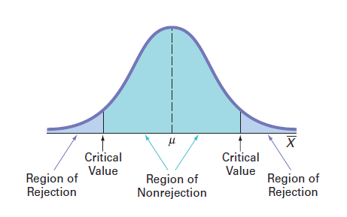

Slide 15
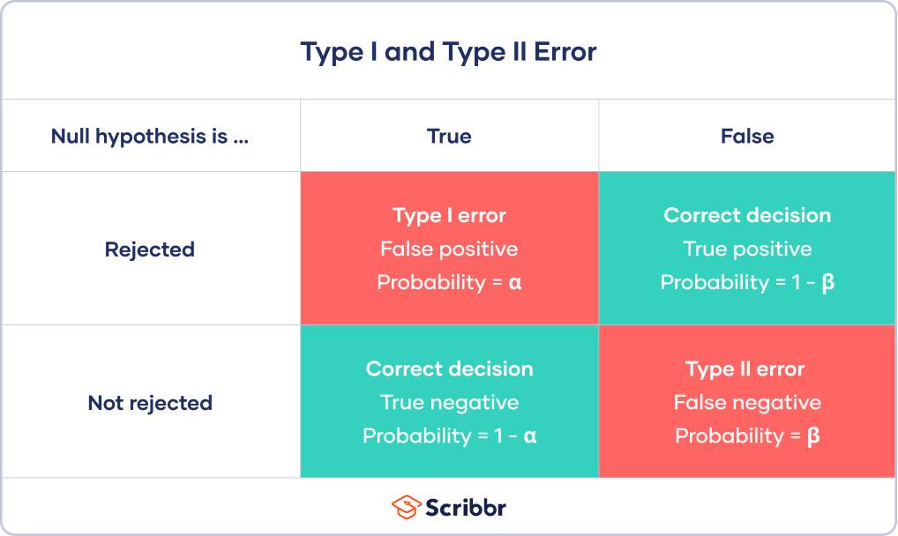
Notes:
1. Type I Error (False Positive)
Definition: A Type I error occurs when the null hypothesis (H₀) is rejected, even though it is actually true.
Consequence: This means you conclude that there is an effect or difference when there is none.
Significance Level (α): The probability of making a Type I error is controlled by the significance level (α), which is usually set at 0.05. This means that there is a 5% chance of rejecting the null hypothesis incorrectly.
Example: If a drug is not effective, but the test results show that it is effective, leading to a false conclusion.
Key Points:
Type I error = Rejecting a true null hypothesis.
Minimize by choosing a smaller significance level (e.g., α = 0.01).
2. Type II Error (False Negative)
Definition: A Type II error occurs when the null hypothesis is not rejected, even though the alternative hypothesis (H₁) is true.
Consequence: This means you conclude that there is no effect or difference when there actually is one.
Power (1 - β): The probability of avoiding a Type II error is related to the power of the test. Increasing the sample size or effect size improves the power, reducing the likelihood of a Type II error.
Example: If a drug is effective, but the test results show no significant difference between the drug and a placebo, leading to a missed detection of the effect.
Key Points:
Type II error = Failing to reject a false null hypothesis.
Minimize by increasing the sample size or the test's sensitivity.
Balancing the Errors:
Reducing Type I error (e.g., by lowering α) increases the risk of a Type II error, and vice versa.
Researchers need to balance these risks based on the context of the study, considering the consequences of making either type of error. For example, in medical testing, reducing Type I errors might be prioritized to avoid false claims about a treatment's effectiveness.

Slide 16
Is a Type I or Type II error worse?
Random callouts

Slide 17
Is a Type I or Type II error worse?
For statisticians, a Type I error is usually worse. In practical terms, however, either type of error could be worse depending on your research context.
A Type I error means mistakenly going against the main statistical assumption of a null hypothesis. This may lead to new policies, practices or treatments that are inadequate or a waste of resources

Slide 18
How do you reduce the risk of making a Type I error?
Choosing the right significance value. The value you set at the beginning of your study to assess the statistical probability of obtaining your results (p value)
The significance level is usually set at 0.05 or 5%. This means that your results only have a 5% chance of occurring, or less, if the null hypothesis is actually true.
To reduce the Type I error probability, you can set a lower significance level.
Notes:
Example: Instead of using α = 0.05, you might set α = 0.01, meaning there is only a 1% chance of rejecting the null hypothesis when it is actually true. Summary of Strategies:
Lower α level (e.g., from 0.05 to 0.01).
Choose the appropriate test that fits the data assumptions.
Apply corrections (like Bonferroni) for multiple comparisons.
Increase the sample size to get more accurate estimates.
Use two-tailed tests when the direction of the effect is uncertain.

Slide 19
How do you reduce the risk of making a Type II error?
The risk of making a Type II error is inversely related to the statistical power of a test. Power is the extent to which a test can correctly detect a real effect when there is one.
Increase Sample Size
Increase the Significance Level (α)
Use a More Sensitive Test
Increase the Effect Size
Use One-Tailed Tests (When Appropriate)
Notes:
Increase Sample Size
A larger sample size provides more data and improves the test's ability to detect a true effect. By increasing the sample size, the test becomes more sensitive to differences between groups, reducing the likelihood of a Type II error. Example: Suppose a researcher is testing whether a new drug is effective in reducing blood pressure. With a small sample size of only 20 participants, the researcher might fail to detect a significant effect, even if the drug is effective. By increasing the sample size to 100 participants, the test has a higher chance of identifying the true effect, reducing the risk of a Type II error.
Increase the Significance Level (α)
A more relaxed significance level (e.g., moving from α = 0.01 to α = 0.05) can increase the power of the test and make it easier to detect an effect. However, this also increases the risk of a Type I error (false positive), so the balance between Type I and Type II errors must be considered.
Example: In the same drug study, if the researcher initially set the significance level at 0.01, they might miss a real effect (Type II error). By changing the level to 0.05, the test becomes more likely to detect the true effect.
Increase the Effect Size
When designing a study, researchers can attempt to maximize the difference between groups. A larger effect size is easier to detect, reducing the chance of a Type II error.
Example: If the drug is administered at a low dose, the effect might be too small to detect. By increasing the dosage (within safe limits), the effect might become more pronounced, making it easier to find significant differences between the drug group and the control group.
If a hypothesis is directional (predicting an effect in a specific direction), using a one-tailed test can increase power, as it allocates all of the significance level to testing the effect in one direction.
Example: If the drug is only expected to reduce blood pressure (not increase it), a one-tailed test might increase the chances of detecting the effect compared to a two-tailed test.

Slide 20
Example
Random callouts
Scenario:
Suppose you are a researcher testing the effectiveness of a new drug that claims to lower blood pressure. Your hypothesis test involves:
State the Null and Alternative Hypothesis
Notes:
Type I Error (False Positive):
Definition: Rejecting the null hypothesis when it is actually true.
Example: After conducting your experiment, you find that the data suggest the drug significantly lowers blood pressure, so you reject the null hypothesis. However, in reality, the drug doesn’t lower blood pressure, and the result you observed was just due to random chance. In this case, you’ve made a Type I error by falsely concluding that the drug works when it doesn't.
Real-world consequence: Patients might start using an ineffective drug, wasting resources and potentially causing harm by relying on a treatment that doesn't actually help.
Type II Error (False Negative):
Definition: Failing to reject the null hypothesis when it is actually false.
Example: After running your test, the results show no statistically significant effect, so you fail to reject the null hypothesis and conclude that the drug doesn’t lower blood pressure. However, in reality, the drug does lower blood pressure, and your test failed to detect this effect. You’ve made a Type II error by missing the real impact of the drug.
Real-world consequence: A potentially effective drug might be disregarded, and patients may miss out on a treatment that could help them lower their blood pressure.

Slide 21
Example
Scenario:
Suppose you are a researcher testing the effectiveness of a new drug that claims to lower blood pressure. Your hypothesis test involves:
Null Hypothesis (H₀): The new drug has no effect on blood pressure (it is no different from a placebo).
Alternative Hypothesis (H₁): The new drug lowers blood pressure (it has a significant effect).
Notes:
Type I Error (False Positive):
Definition: Rejecting the null hypothesis when it is actually true.
Example: After conducting your experiment, you find that the data suggest the drug significantly lowers blood pressure, so you reject the null hypothesis. However, in reality, the drug doesn’t lower blood pressure, and the result you observed was just due to random chance. In this case, you’ve made a Type I error by falsely concluding that the drug works when it doesn't.
Real-world consequence: Patients might start using an ineffective drug, wasting resources and potentially causing harm by relying on a treatment that doesn't actually help.
Type II Error (False Negative):
Definition: Failing to reject the null hypothesis when it is actually false.
Example: After running your test, the results show no statistically significant effect, so you fail to reject the null hypothesis and conclude that the drug doesn’t lower blood pressure. However, in reality, the drug does lower blood pressure, and your test failed to detect this effect. You’ve made a Type II error by missing the real impact of the drug.
Real-world consequence: A potentially effective drug might be disregarded, and patients may miss out on a treatment that could help them lower their blood pressure.

Slide 22
Key Differences between Type I & II Errors
Type I error is the same as a false alarm or false positive while Type II error is also referred to as false negative.
A Type I error is represented by α while a Type II error is represented by β
The level of significance determines the possibility of a type I error while type II error is the possibility of deducting the power of the test from 1
In statistical hypothesis testing, a type I error is caused by disapproving a null hypothesis that is otherwise correct while in contrast, Type II error occurs when the null hypothesis is not rejected even though it is not true.
Type I error occurs when you reject the null hypothesis, in contrast, Type II error occurs when you accept an incorrect outcome of a false hypothesis

Slide 23
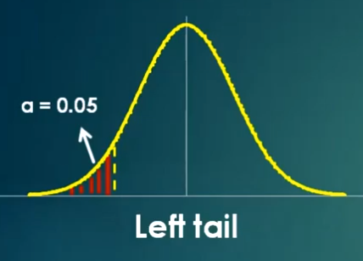
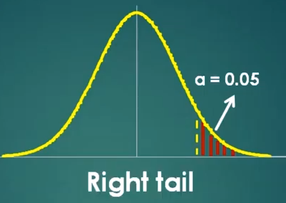
One Tail and Two Tail Test
A one-tail test is a statistical test where the critical region of the distribution is one-sided
It can either greater than or less than a certain value, but it cannot be both
A one-tail test can be further classified as either a right-tail test or a left tail test

Slide 24
One Tail and Two Tail Test
If the sample being tested falls in either of the two regions then the alternative hypothesis is accepted.
Example
we may wish to compare the mean of a sample to a given value x using a t-test. Our null hypothesis is that the mean is equal to x. A two-tailed test will test both if the mean is significantly greater than x and if the mean significantly less than x.
The mean is considered significantly different from x if the test statistic is in the top 2.5% or bottom 2.5% of its probability distribution, resulting in a p-value less than 0.05.

Slide 25
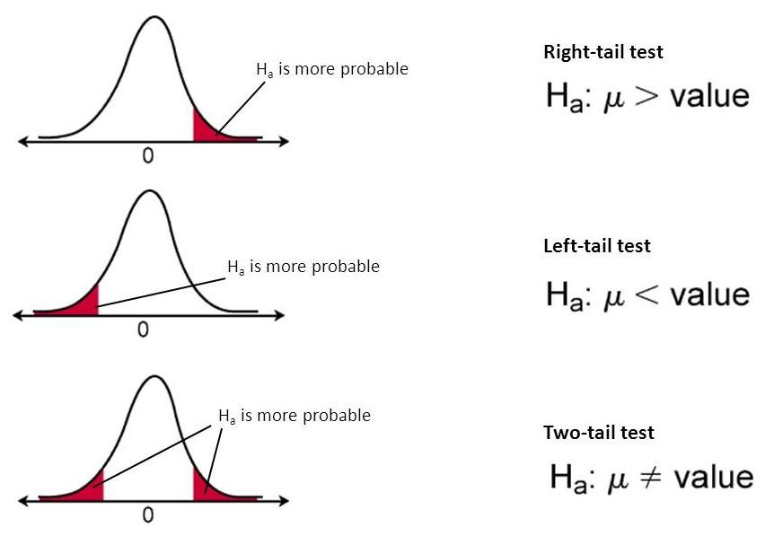

Slide 26
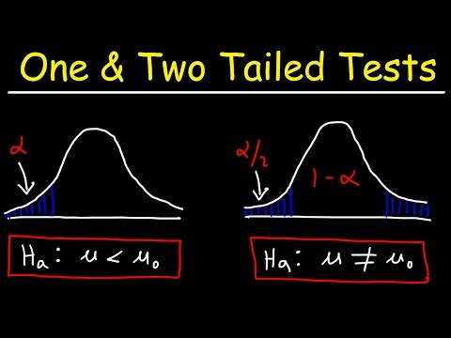
Notes:
When deciding whether to use a one-tailed or two-tailed test, the choice depends on the research question or hypothesis you are testing. Let’s explore this with an example of a company that produces bags of chips with an advertised weight of 100 grams.
Two-Tailed Test Example:
Suppose the company wants to test whether the average weight of their chip bags is different from 100 grams (either higher or lower). Here, the company is interested in deviations in both directions (more or less than 100g).
Hypotheses:
Null hypothesis (H₀): The average weight of the chip bags is 100g. H0:μ=100H₀: \mu = 100H0​:μ=100
Alternative hypothesis (H₁): The average weight of the chip bags is not equal to 100g (could be more or less). H1:μ≠100H₁: \mu \neq 100H1​:μ=100
In this case, a two-tailed test is appropriate because you are testing for the possibility of both an increase or a decrease in the average weight. If the test statistic falls in either tail of the distribution, you would reject the null hypothesis.
One-Tailed Test Example:
Now, let’s say the company is only concerned about whether their machines are underfilling the bags, i.e., producing bags with a weight less than 100 grams. The company isn't worried about overfilling; they just want to ensure the bags are not underfilled. In this case, you're only interested in one direction — whether the average weight is less than 100g.
Hypotheses:
Null hypothesis (H₀): The average weight of the chip bags is 100g or more. H0:μ≥100H₀: \mu \geq 100H0​:μ≥100
Alternative hypothesis (H₁): The average weight of the chip bags is less than 100g. H1:μ<100H₁: \mu < 100H1​:μ<100
In this case, a one-tailed test is appropriate because you're only testing whether the average weight is less than 100g (not both directions). If the test statistic falls in the left tail (indicating underfilling), you would reject the null hypothesis.
When to Use Each Test:
Use a two-tailed test when you're testing for any significant difference in either direction (higher or lower) from the hypothesized value (e.g., the weight could be either more or less than 100g).
Use a one-tailed test when you're only concerned with deviations in one direction (e.g., only interested in underfilling or overfilling, not both).
Summary:
Two-tailed test: Tests for differences in either direction. Example: "Is the average weight different from 100g?"
One-tailed test: Tests for differences in only one direction. Example: "Is the average weight less than 100g?" (or alternatively, "Is it greater than 100g?").

Slide 27

Test Statistic
A test Statistic is a random variable that is calculated from sample data and used in a hypothesis test. Either to reject or accept the null hypothesis.

Slide 28
P-value
A p-value is a number that tells us how likely it is to get the results we observed in a study, assuming the null hypothesis (no effect or difference) is true. It helps us decide if our findings are statistically significant or just due to chance.
Small p-value (usually less than 0.05): There is strong evidence that what we observed is real, and we should reject the null hypothesis.
Large p-value (greater than 0.05): There is not enough evidence to say the result is significant, so we do not reject the null hypothesis.

Slide 29
Example of P-value
Suppose you want to test if a new teaching method improves student test scores compared to the old method.
Null hypothesis (H₀): There is no difference between the new and old teaching methods.
Alternative hypothesis (H₁): The new teaching method improves scores.
You conduct a test and find a p-value of 0.02.
Interpretation: Since the p-value (0.02) is less than 0.05, you can reject the null hypothesis and conclude that the new teaching method likely improves scores. The result is statistically significant, meaning it's unlikely to be due to chance.

Slide 30

Any Stumbles ?

Slide 31
Thanks!
Have an amazing week ahead. Stay safe.
Sam

Slide 32


We value you!

